Slide 1





Google Deep Learning APIs

Slide 2
Video Overview
APIs: Vision, Speech, Natural Language, Video Intelligence
Training Datasets and Neural Networks
Authentication and API keys
Dataset

Slide 3


Google Deep Learning APIs
Natural Language, Speech, Vision and Video Intelligence
Feature extraction
object identification, sentiment analysis, named entity recognition
Data transformation
Translation, text-to-speech or speech-to-text
Process
Create a JSON file with the elements of the request
Send the data to the API
get a JSON response with the results of the processing.

Slide 4
Training datasets
MS-COCO for object detection, cocodataset.org
330K images
1.5 million object instances in 80 object categories
ImageNet, based on wordnet, image-net.org
1.5M labeled images
22k different object categories
Open Images V4 dataset, storage.googleapis.com/openimages/web
Largest existing dataset with object location annotations
Released in May 2018
1.9M images with 15.4M bounding-boxes for 600 categories
And 30.1M human-verified image-level labels for 20k categories

Slide 5
Datasets for Object Classification
MS-COCO
330K images, 80 object categories, 5 captions/image
ImageNet
1.5 Million images related to 100k WordNet synsets
Open Images
30.1M human-verified image labels over 20k categories
VisualQA, CIFAR-10, Fashion-MNIST, …

Slide 6


Neural Networks Architectures
Data
Results
Input layer
Hidden layer
Hidden layer
Output layer
Jobs API

Slide 7
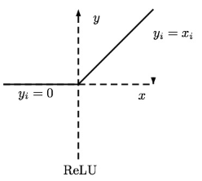
Feed-Forward Neural Network Architecture
Network Depth
Non-linear activation function
Data
Results
Input layer
Hidden layer
Hidden layer
Output layer

Slide 8
Recurrent Neural Network Architecture
Data
Results
Input layer
Hidden layer
Hidden layer
Output layer

Slide 9
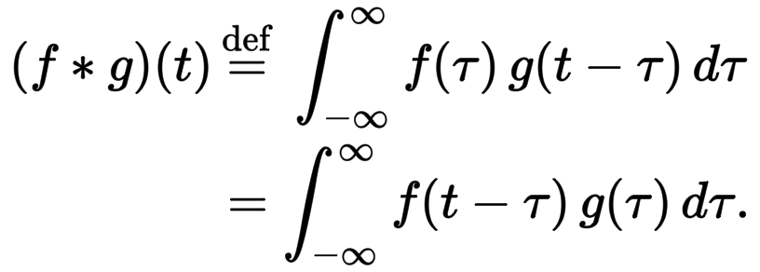
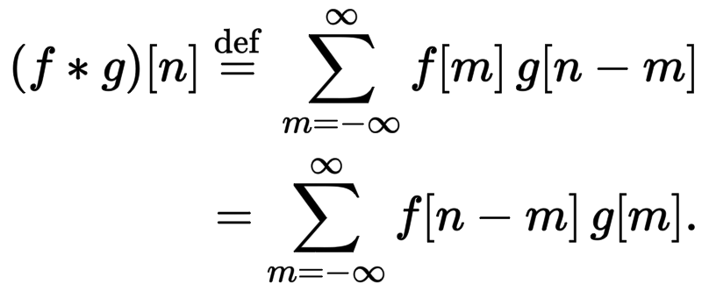
Convolution
Mathematical operation that measures the similarity of 2 functions
Continuous
Discrete

Slide 10
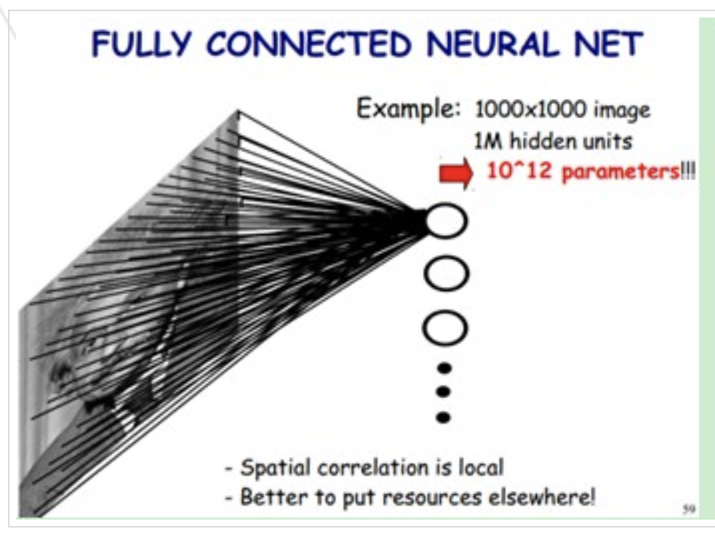
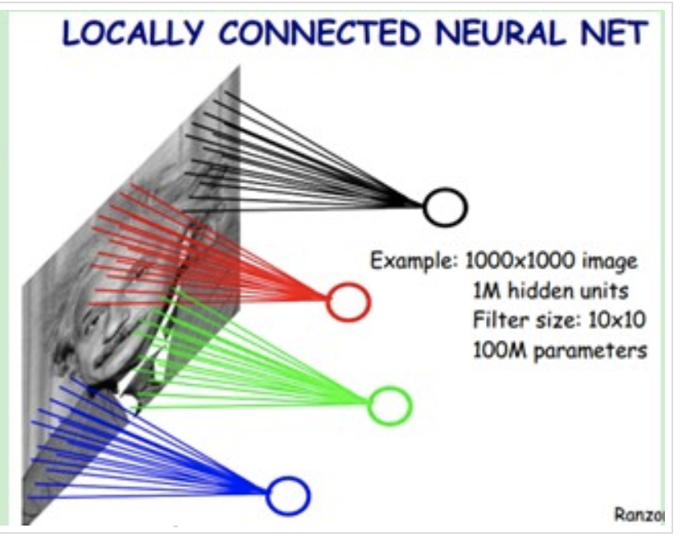
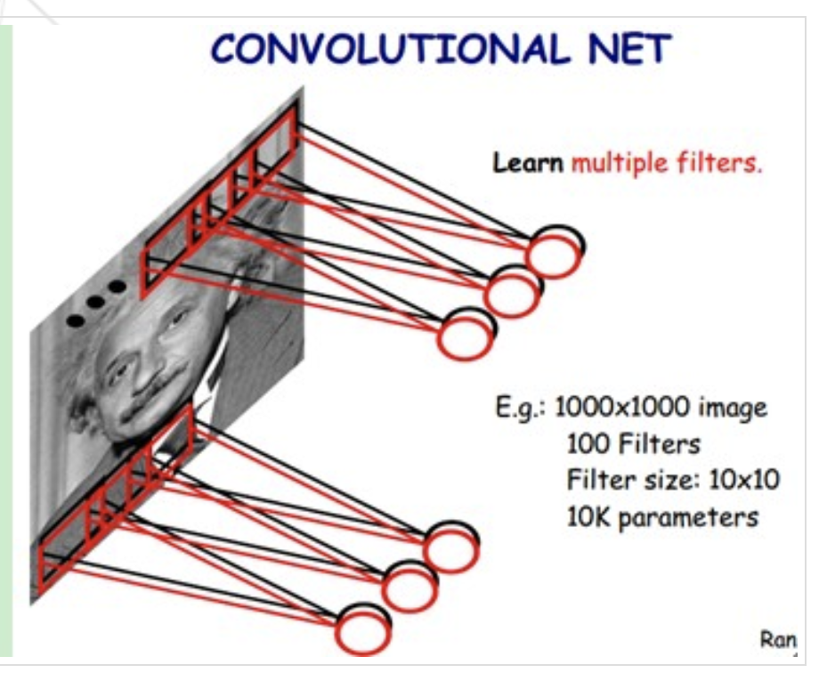
Convolution Neural Network
Fully connected NN
1000 × 1000 × 10^6 = 10^12
Locally connected NN
10 × 10 × 10^6 = 10^8
Convolution NN
10 x 10 x 100= 10^4

Slide 11
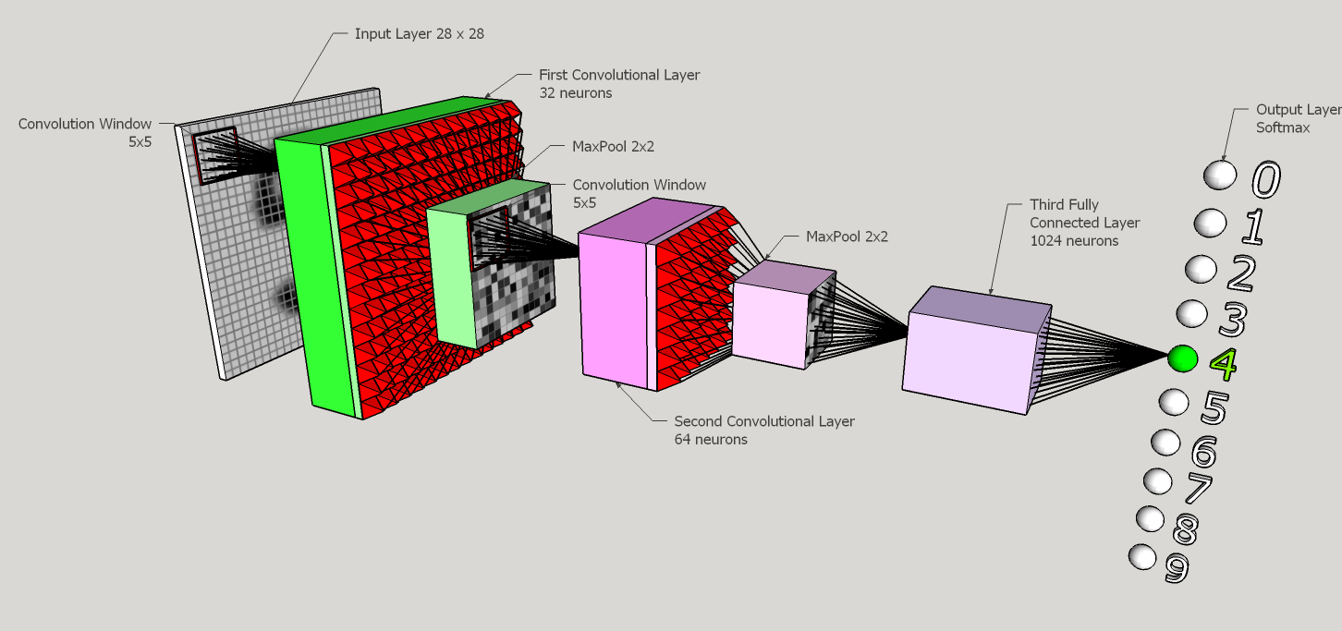
Convolution Neural Network
http://www.zderadicka.eu/revival-of-neural-networks/

Slide 12
Convolution Neural Network
Reduces the number of parameters
Making deeper networks possible
Extracts more meaningful information
Different Kernels bring different functionalities
Contour and edge detection
Blurring or sharpening the image

Slide 13
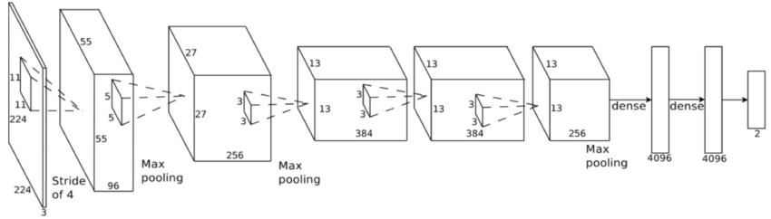
AlexNet - 2012
5 convolution layers followed by 3 fully connected layers
60 million parameters
https://www.jeremyjordan.me/convnet-architectures/

Slide 14
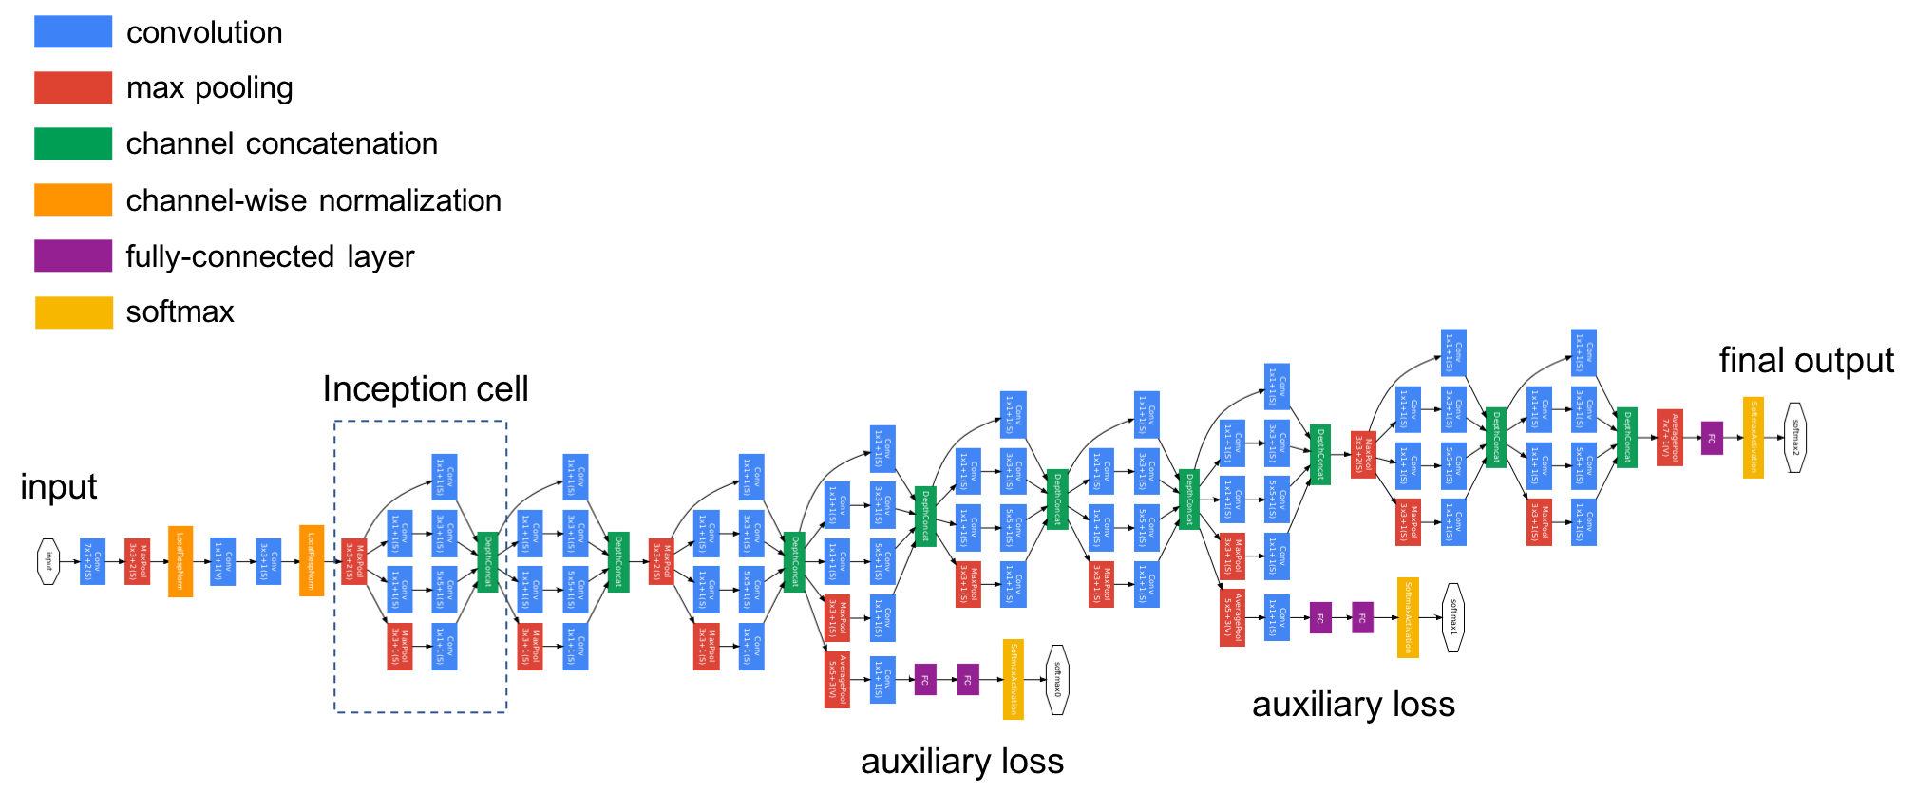
Inception - 2014
https://www.jeremyjordan.me/convnet-architectures/

Slide 15
Our dataset
A small dataset to illustrate the Google Deep Learning APIs
Reddit Jazz forum for Nov 2017
900 comments
57 urls for images and videos
Extracted from BigQuery
SELECT * FROM [fh-bigquery:reddit_posts.2017_11] WHERE subreddit = 'Jazz'

Slide 16
The next 4 videos focus on each Google Deep Learning API Thank you for watching

